Slide 1
Proposal for extracting species names for US 6-site community phylogeny
Miao Sun
Hanyang Lin

Slide 2
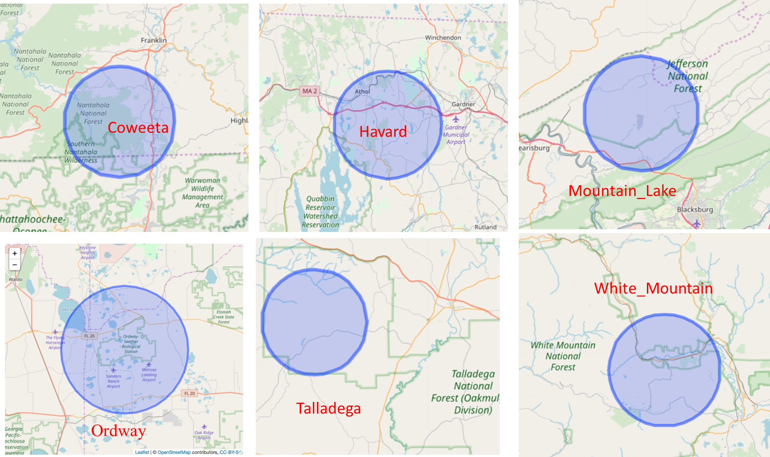
Recap:
What I did earlier is using Centered coordinated of each site making a 10-km radius ring and then extract Seed plant accepted names from iDigBio + GBIF + Mark’s original species list

Slide 3
General information for US-CN 11 site in total
Note: the species number were generate by previous Miao’s 10-km radius ring approach, not current; ignore.

Slide 4
Our new approach:
Project tree species sampling coordinates for each of 6 sites (black dots in the map)
Make a dark blue ring using centered coordinates (yellow dot) of each site with 10-km radius (Miao’s earlier approach); All the rings in the map are in the same size, the visual difference is caused by scale.
The red shed area is vectorized national forests range (or part; depends on it’s relation with samples geocode and 10km-radius ring)
Then based on these spatial relationships, We proposed one potential polygon; then we use this polygon to extract those species names as our target for community phylogeny.
Please make your comments and suggestions.

Slide 5
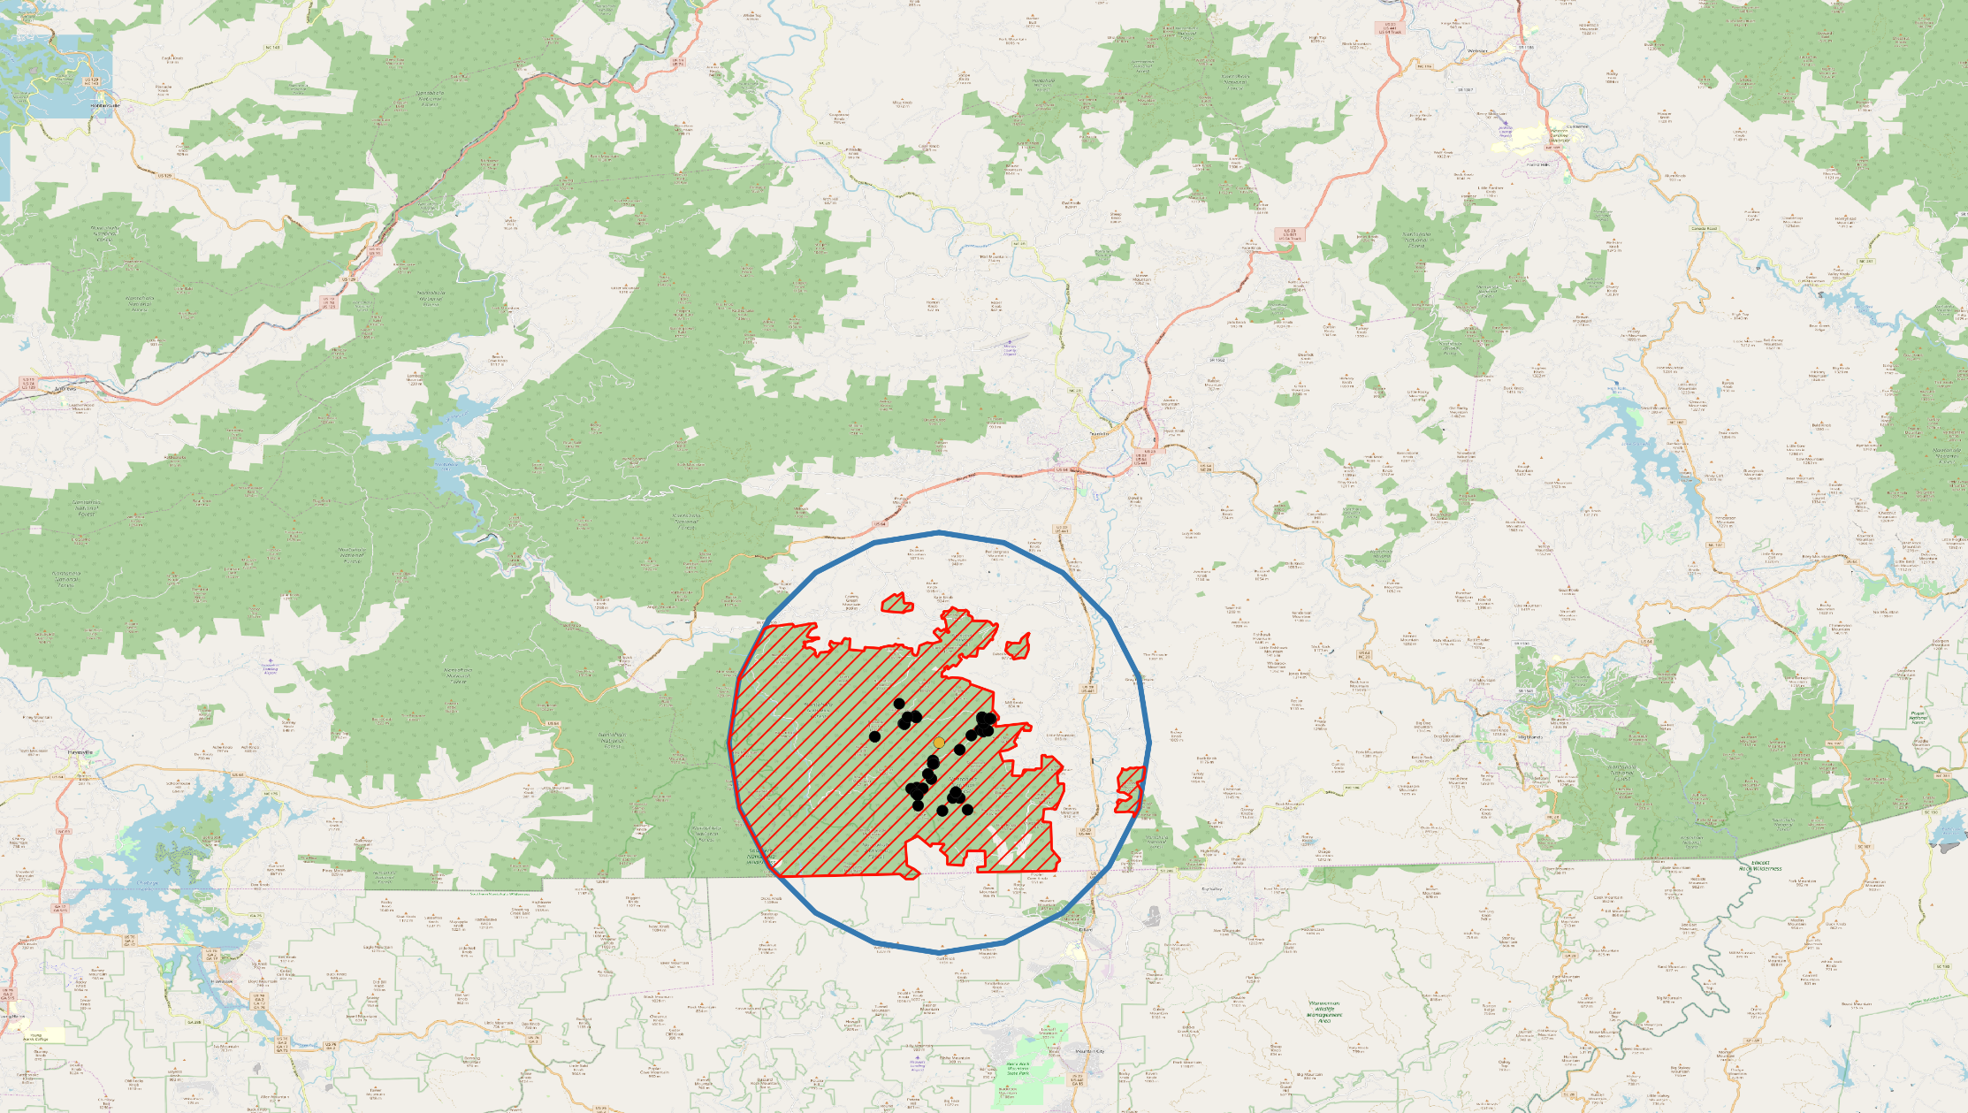
Coweeta
For Coweeta site, we suggest go with the red shed polygon to extract our species list.
Maybe excluding those tiny small areas (skyblue arrow) on the edge

Slide 6
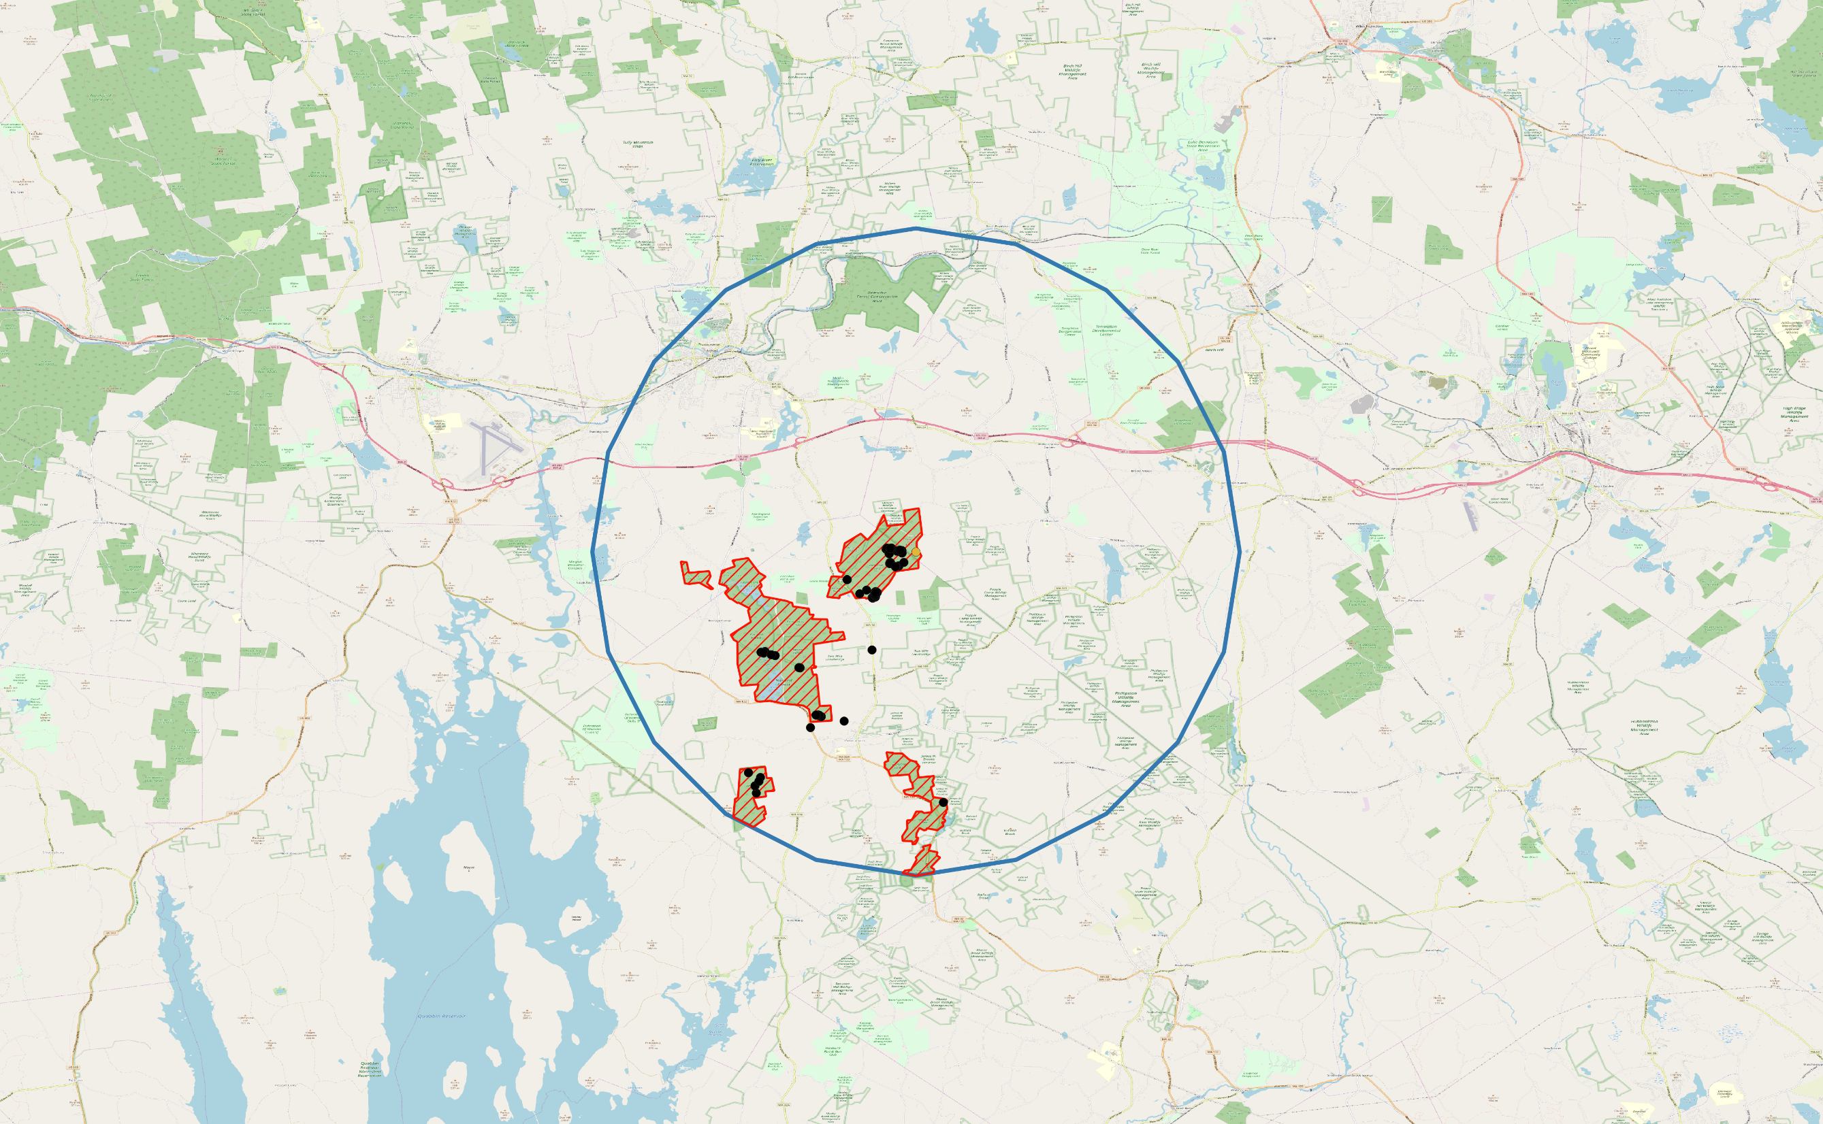
Harvard
Harvard forest
For Harvard site, we suggest take the whole the red shed polygon to extract our species list.

Slide 7
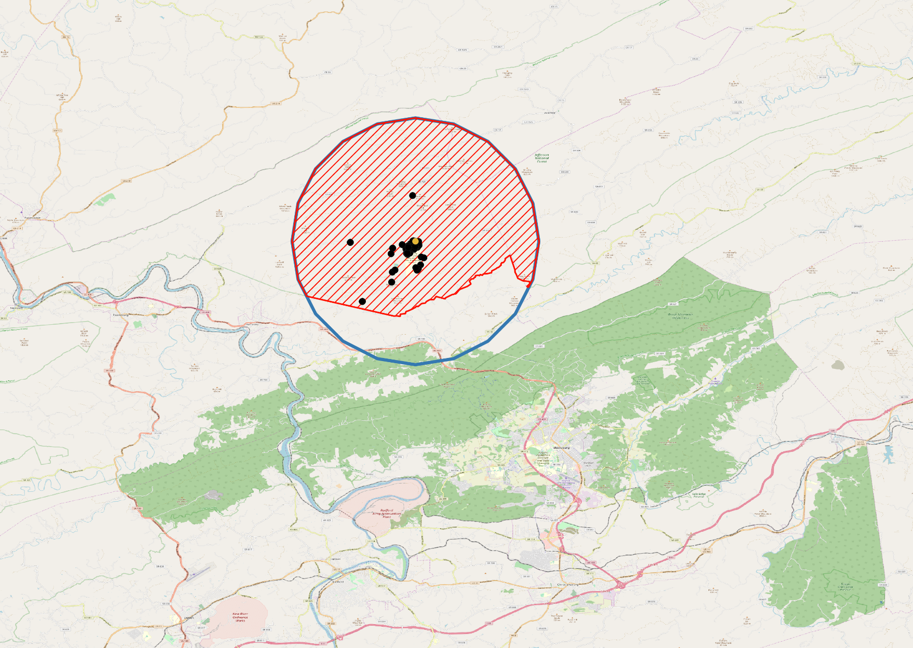
Mountain Lake
Mountain Lake Station
Zoom in
For Mountain Lake
site, we suggest take the whole the red shed polygon to extract our species list.

Slide 8
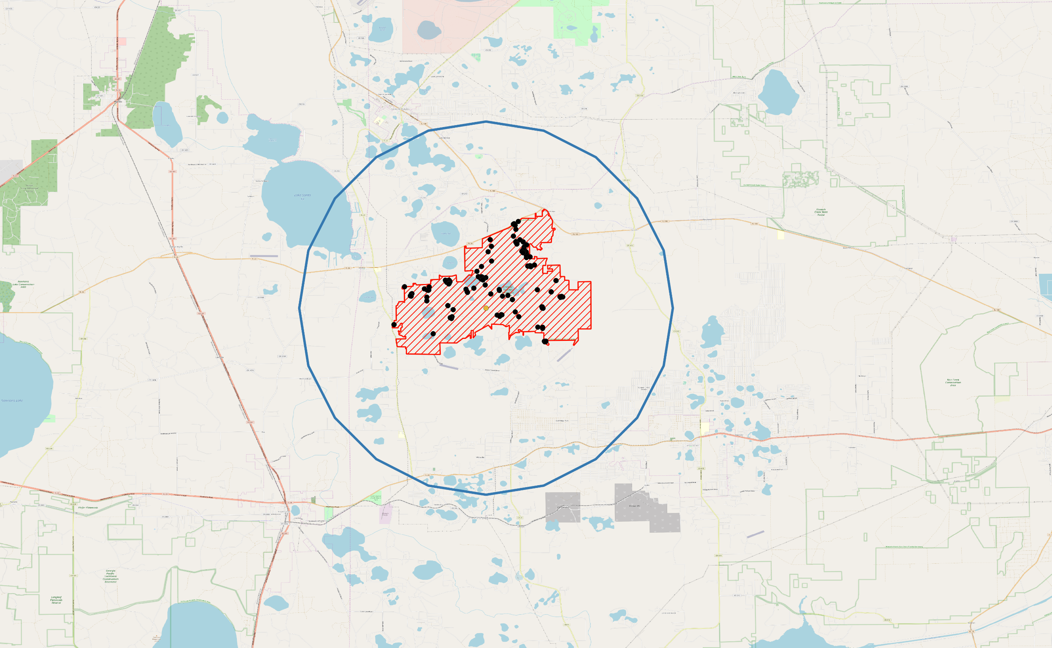
Ordway
Ordway-Swisher Biological Station
For Ordway-Swisher Biological Station
site, we suggest take the whole the red shed polygon to extract our species list.

Slide 9
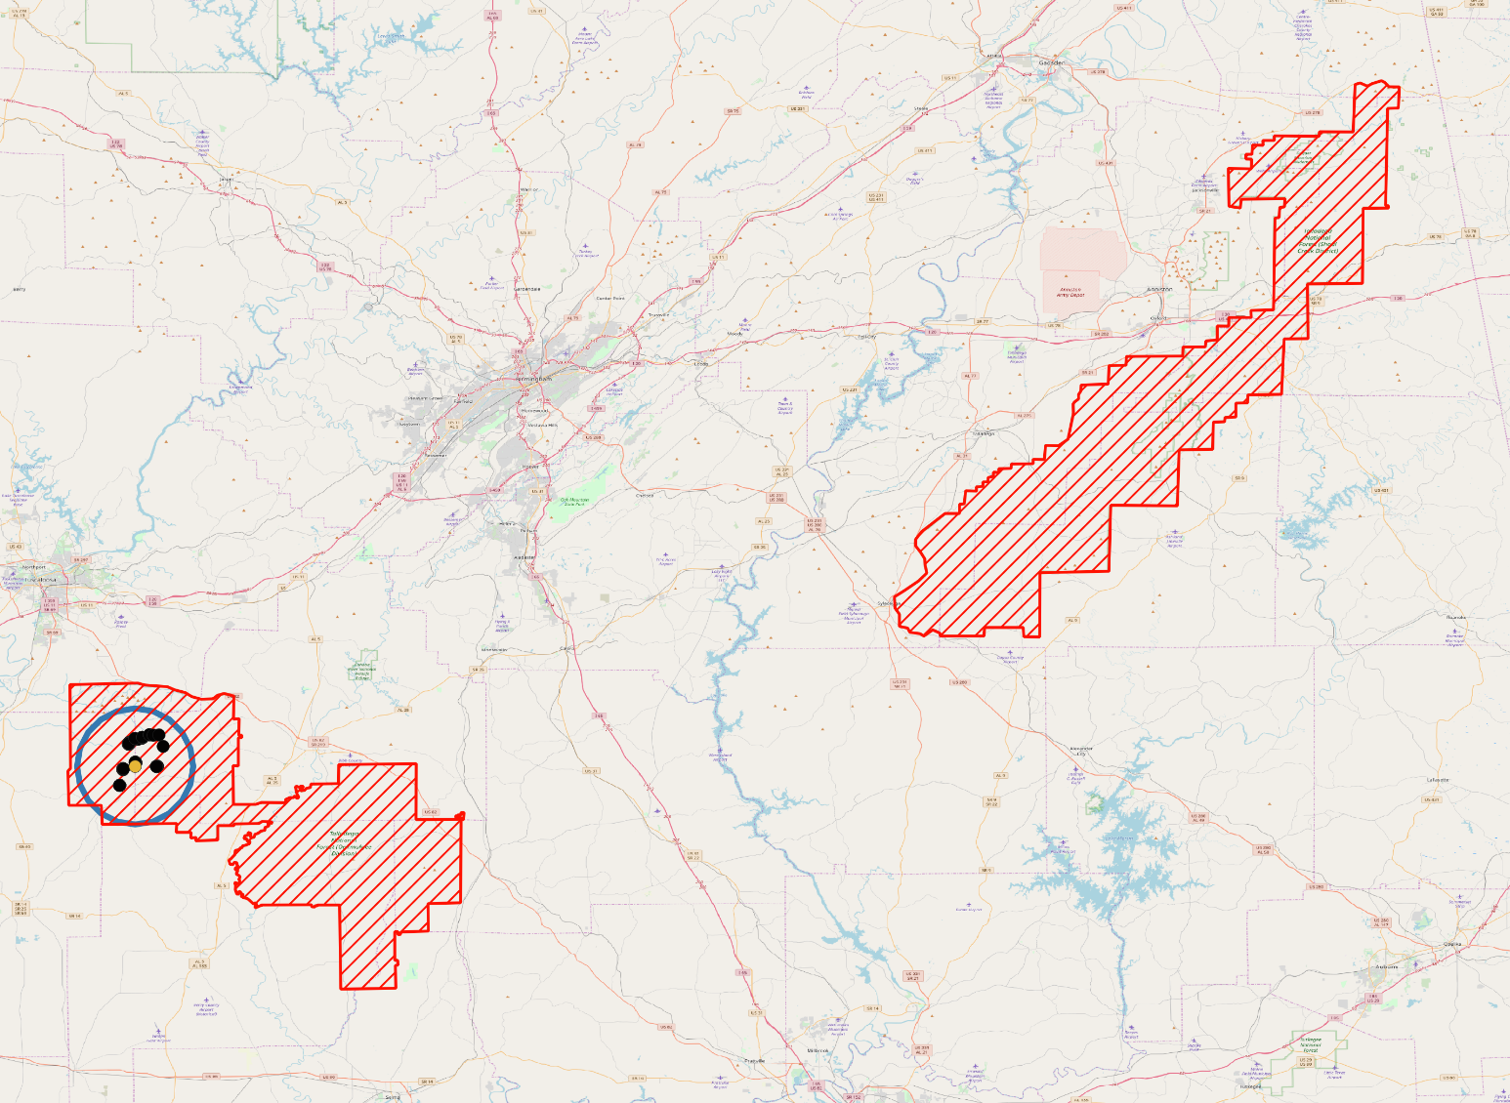
Talladega
Talladega National Forest
For Talladega site, we suggest only take the whole ring to extract our species list.
Talladega National Forest
(Oakmulgee Diviosn)

Slide 10
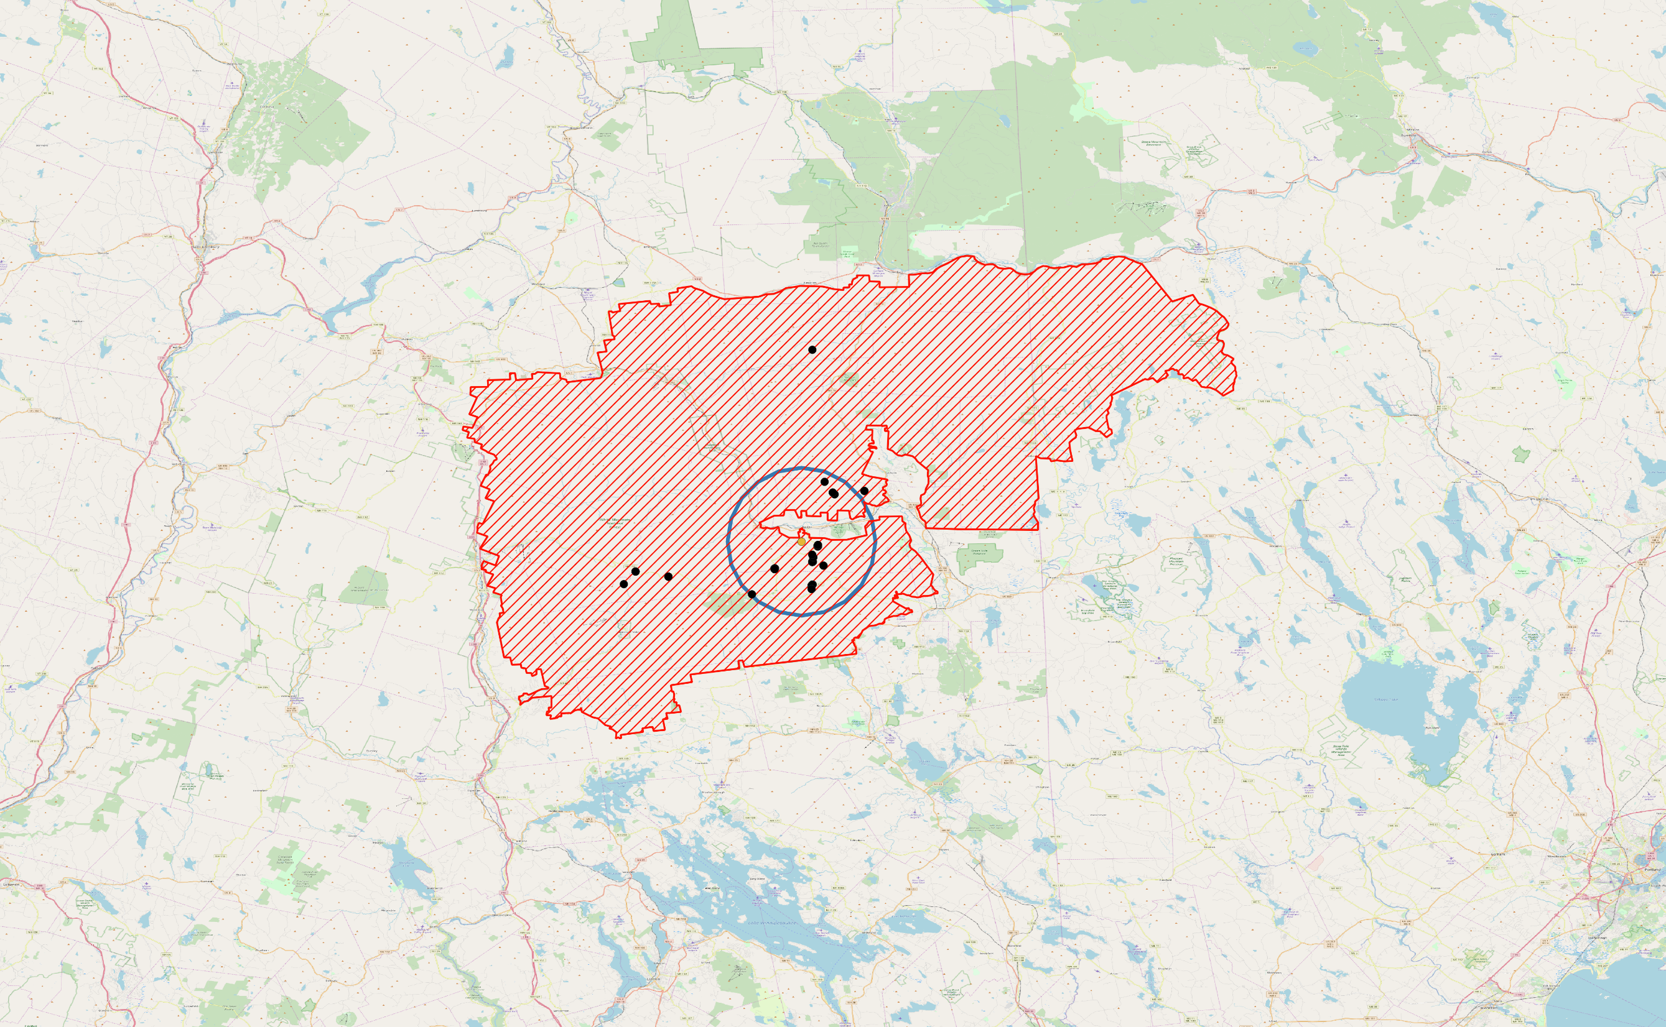
White Mountain
White Mountain
For White Mountain site, we suggest only take the whole ring to extract our species list? Or move the ring inside 5km?
Concern is the non-station space in the center.

